Slide 1
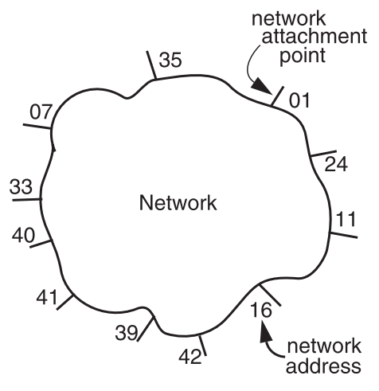
The network layer
Addressing interface
  Network attachment points
  Network address
  Source & destination
NETWORK_SEND (segment_buffer, destnation,
network_protocol, end_layer_protocol)
NETWORK_HANDLE (packet, network_protocol)

Slide 2
Network layer interface
structure packet
bit_string source
bit_string destination
bit_string end_protocol
bit_string payload

Slide 3
1 procedure NETWORK_SEND (segment_buffer, destination,
2 net_protocol, end_protocol)
3 packet instance outgoing_packet
4 outgoing_packet.payload ← segment_buffer
5 outgoing_packet.end_protocol ← end_protocol
6 outgoing_packet.source ← MY_NETWORK_ADDRESS
7 outgoing_packet.destination ← destination
8 NETWORK_HANDLE (outgoing_packet, net_protocol)
9 procedure NETWORK_HANDLE (net_packet, net_protocol)
10 packet instance net_packet
11 if net_packet.destination != MY_NETWORK_ADDRESS then
12 next_hop ← LOOKUP (net_packet.destination, forwarding_table)
13 LINK_SEND (net_packet, next_hop, link_protocol, net_protocol)
14 else
15 GIVE_TO_END_LAYER (net_packet.payload,
16 net_packet.end_protocol, net_packet.source)

Slide 4
GIVE_TO_END_LAYER
NETWORK_SEND
GIVE_TO_NETWORK
_HANDLER
net_handler[]
struct packet
source
destination
end_protocol
payload
NETWORK_HANDLE
LOOKUP
LINK_SEND
LINK_RECEIVE
struct frame
struct checked_cnt
net_protocol
payload
checksum
link_protocol[]
sendproc
sendproc

Slide 5
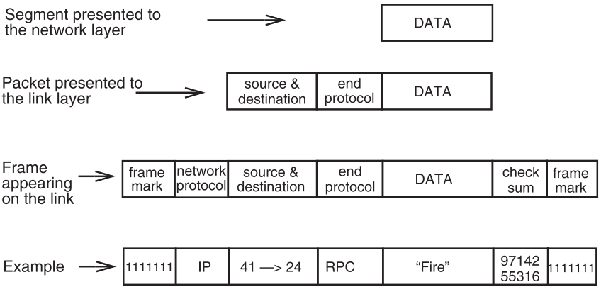
Accumulation of headers and trailers

Slide 6
Questions
Why NETWORK_HANDLE rather than NETWORK_RECEIVE?
  Packet forwarding
  Source can send to itself
Why NETWORK_SEND calls NETWORK_HANDLE rather than GIVE_TO_NETWORK_HANDLER?
  It should be…
What does LOOKUP do?
  Check forwarding table

Slide 7
Managing the forwarding table: routing
Routing (or path-finding)
  Constructing the tables
Impractical by hand
  Determining the best paths requires calculation
  Recalculating the table when links change
  Recalculating the table when link fails
  Adapt according to traffic congestion
Static routing vs. adaptive routing
  Adaptive routing requires exchange of info

Slide 8
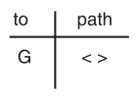
Path vector exchange
Each participant maintains a path vector
  A complete path to some destination
  E.g. zero-length path to itself
  Gradually learns about other paths
  Construct a new forwarding table from its new path vector
Algorithm
  Advertising
  Path selection

Slide 9
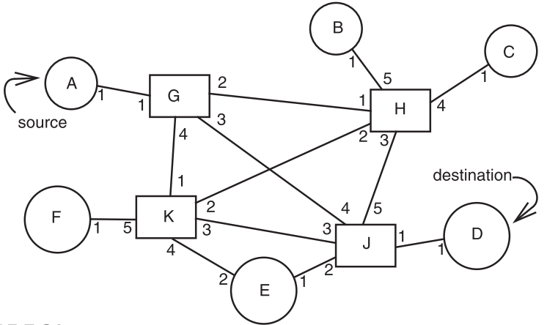
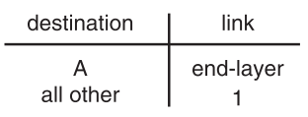
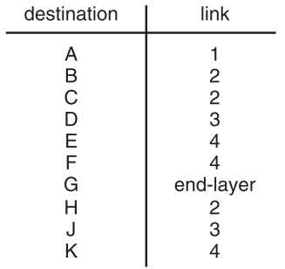
Path vector exchange
A
G
Need coordination, NO loop ?

Slide 10
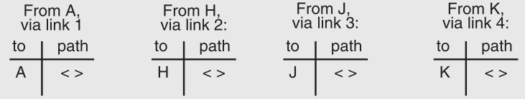
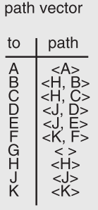
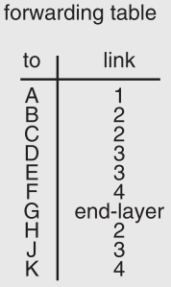
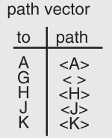
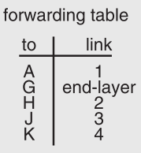
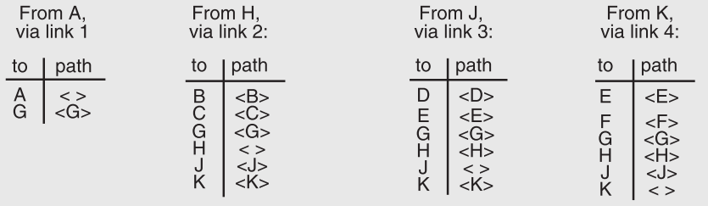

Slide 11
Adaptive routing table
Add a new link
A Link is down
Converge ?
Hop limit
Service node E will not transit

Slide 12
Path vector exchange routing algorithm
// Maintain routing and forwarding tables.
vector associative array // vector[d_addr] contains path
to destination d_addr
neighbor_vector instance of vector // A path vector
received from some neighbor
my_vector instance of vector // My current path vector.
addr associative array // addr[j] is the address of the
network attachment point at the
other end of link j. my_addr is
address of my network attachment
point. A path is a parsable list
of addresses, e.g. {a,b,c,d}

Slide 13
Path vector exchange routing algorithm
procedure main()
SET_TYPE_HANDLER (HANDLE_ADVERTISEMENT,
exchange_protocol)
clear my_vector;
do occasionally
for each j in link_ids do
status ← SEND_PATH_VECTOR (j, my_addr, my_vector,
exch_protocol)
if status != 0 then
clear new_vector
FLUSH_AND_REBUILD (j)

Slide 14
Path vector exchange routing algorithm
procedure HANDLE_ADVERTISEMENT (advt, link_id)
addr[link_id] ← GET_SOURCE (advt)
neighbor_vector ← GET_PATH_VECTOR (advt)
for each neighbor_vector.d_addr do
new_path ← {addr[link_id], neighbor_vector[d_addr]}
if my_addr is not in new_path then
if my_vector[d_addr] = NULL) then
my_vector[d_addr] ← new_path
else
my_vector[d_addr] ← SELECT_PATH (new_path,
my_vector[d_addr])
FLUSH_AND_REBUILD (link_id)

Slide 15
Path vector exchange routing algorithm
procedure SELECT_PATH (new, old)
if first_hop(new) = first_hop(old) then return new
else if length(new) ≥ length(old) then return old
else return new
procedure FLUSH_AND_REBUILD (link_id)
for each d_addr in my_vector
if first_hop(my_vector[d_addr]) = addr[link_id]
and new_vector[d_addr] = NULL
then
delete my_vector[d_addr]
REBUILD_FORWARDING_TABLE (my_vector, addr)

Slide 16
Hierarchical address assignment & routing
Two problems of the above implementation
  Every attachment point must have a unique address
  The path vector grows in size with the number of attachment points
Hierarchy
  Tow parts of network address: region & station
    E.g. “11,75”
  Regions correspond to the set of closely-connected entities
  Region 11 has only 1 entry in other region routers’ table
  First forward to region, then to station

Slide 17
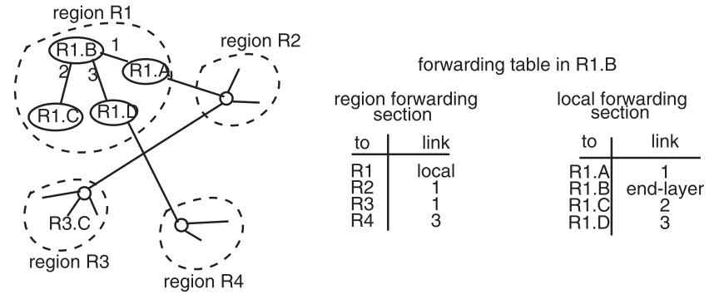
Hierarchical address assignment & routing

Slide 18
Hierarchical address assignment & routing
Problems introduced by hierarchy
  More complex
  Binding address with location
    Has to change address after changing location
  Paths may no longer be the shortest possible
    Algorithm has less detailed information
More about hierarchy
  Can extend to more levels
  Different places can have different levels

Slide 19
Reporting network layer errors
Typical error reports
  The buffers of the router were full, so the packet had to be discarded
  The buffers of the router are getting full—please stop sending so many packets
  The region identifier part of the target address does not exist
  The station identifier part of the target address does not exist
  The end type identifier was not recognized
  The packet is larger than the maximum transmission unit of the next link
  The packet hop limit has been exceeded
What about sending report when checksum is error?

Slide 20
Reporting network layer errors
Cross layers error message
  Originates in the network layers, is delivered to the end-to-end layer
  Violating the separation of layers?
Error reporting protocol: best-effort
  Reliable protocol adds a lot
  Can be thought of hints, not essential
  E.g. ICMP
    ping
  Hop limit exceeded
  Learn the smallest MTU by “MTU exceeded” error

Slide 21
NAT (Network Address Translation)
Private network
  Public routers don’t accept routes to network 10
NAT router: bridge the private networks
  Router between private & public network
  Send: modify source address to temp public address
  Receive: modify back by looking mapping table
Limitations
  Some end-to-end protocol place address in payloads
  The translator may become the bottleneck
  What if two private network merge?

Slide 22
The end-to-end layer

Slide 23
The end-to-end layer
Network layer is not enough
  No guarantees about delay
  Order of arrival
  Certainty of arrival
  Accuracy of content
  Right place to deliver
End-to-end layer
  No single design is likely to suffice
  Transport protocol for each class of application

Slide 24
Transport layer interface for protocol multiplexing
v.1 SEND_MESSAGE (destination, message)
v.1 DELIVER_MESSAGE (message)
/* multiplexing, for both multiple apps and instances */
v.2 SEND_MESSAGE (destination, service_port, message)
v.2 LISTEN_FOR_MESSAGES (service_port, message_handler)
v.2 DELIVER_MESSAGE (source, message)
v.3 SEND_MESSAGE (destination, service_port, reply_port,
message)
v.3 LISTEN_FOR_MESSAGES (service_port, message_handler)
v.3 DELIVER_MESSAGE (source, reply_port, message)
Notes:
V2: source: the address from which this message originated

Slide 25
Famous transport protocols
UDP (User Datagram Protocol)
  Be used directly for some simple applications
  Also be used as a component for other protocols
TCP (Transmission Control Protocol)
  Keep order, no missing, no duplication
  Provision for flow control
RTP (Real-time Transport Protocol)
  Built on UDP
  Be used for streaming video or voice, etc.
Other protocols, as presentation protocols
Notes:
Provision for flow control
sender will not overrun the ability of receiver to accept data

Slide 26
Assurance of end-to-end protocol
Assurance of at-least-once delivery
Assurance of at-most-once delivery
Assurance of data integrity
Assurance of end-to-end performance
Assurance of stream order & closing of connections
Assurance of jitter control
Assurance of authenticity and privacy

Slide 27
1. Assurance of at-least-once delivery
RTT (Round-trip time)
  to_time + process_time + back_time (ack)
At least once on best effort network
  Send packet with nonce
  Sender keeps a copy of the packet
  Resend if timeout before receiving acknowledge
  Receiver acknowledges a packet with its nonce
Sender limit # of retries before return error to app

Slide 28
1. Assurance of at-least-once delivery
App get the error message, interpret the error: (dilema)
  1. The data was not delivered
  2. The data was delivered, but no ACK received
        No way to know which situation
At-least-once delivery
  No absolute assurance for at-least-once
  Ensure if it is possible to get through, the message will get through eventually
  Ensure if it’s not possible to confirm delivery, app will know
  No assurance for no- duplication
Notes:
No absolute assurance : if the server is down, is the ship sank

Slide 29
Timer
Fixed timer: dilemma of fixed timer
  Too short: unnecessary resend
  Too long: take long time to discover lost packets
Adaptive timer
  E.g. Adjust by currently observed RTT, set timer to 150%
  Exponential backoff: , if get a duplicated ACK, wait 1, 2, 4, 8, 16, ... Seconds
  NAK (Negative Acknowledgment)
  Receiver sends a message that lists missing items
  Receiver can count arriving segments rather than timer
  Receiver can have no timer (only once per stream)①
Notes:
NAK：
11， 13，not NAK
11， 13,14,15 NAK
--NAK still need a timer for the last segment

Slide 30
2. Assurance of at-most-once delivery
At-least-once delivery
  Remember state at the sending side
  Tends to generate duplicates
At-most-once delivery
  Maintains a table of received nonce at the receiving side ①
  Problem: the table may grow indefinitely
    Space and search time
    Tombstones
Notes:
At-most-once delivery
① check the coming nonce in the list, if it is old ,disard the segment , send ACK

Slide 31
Duplicate suppression
Monotonically increasing sequence number
  Receiver discards smaller nonce
  Receiver holds the last nonce, one per sender
  1. Should never reuse the old port number
  2. Possibility of making a mistake
    E.g. if sender always gives up after five RTT, then receiver can safely discard nonces that are older than 5 RTT
    It is possible that a packet finally shows up after long delay
Receiver crashes and restarts
  E.g. use a new port number each time the system restarts
  Ignore all packets until 5 RTT has passed since restarting, if sender tries limit times

Slide 32
Exactly-once delivery
Combine at-least-once & at-most-once
NOT ensure a message will eventually be delivered
Only ensure
  If the message is delivered, it will be delivered only once
  If delivery fails, the sender will learn (by no ACK)
  If no ACK, it’s possible that the message was delivered
Two-phase commit can reduce the uncertainty
  Adding a persistent sender of the ACK
No way to completely eliminate the uncertainty

Slide 33
Segments and reassembly of long messages
Bridge the difference between message and MTU
  Message length: determined by application
  MTU: determined by network
Segment contains ID for where it fits
  E.g. “message 914, segment 3 of 7”
  Can be used for at-least-once and at-most-once delivery
Reassembly
  Out-of-order
  Allocating a buffer large enough to hold the message
  Keeping a checklist for segments not arrived

Slide 34
3. Assurance of data integrity
Data integrity
  Receiver gets the same contents as sender
Reliable delivery protocol
  Sender: adds checksum to the end-to-end layer
  Receiver: recalculates the checksum, discards if not match
    Why not send NAK and ask for resending?
Is it redundant since link layer provides checksum?
  Other errors, e.g. in memory copying
The assurance is not absolute
  Someone changes the data and the checksum
  What if a packet is misdelivered and the receiver ACK?
Notes:
Why not send NAK and ask for resending?
The source address corrupted
The assurance is not absolute
What if a packet is misdelivered and the receiver ACK?
Receiver check sender’s address

Slide 35
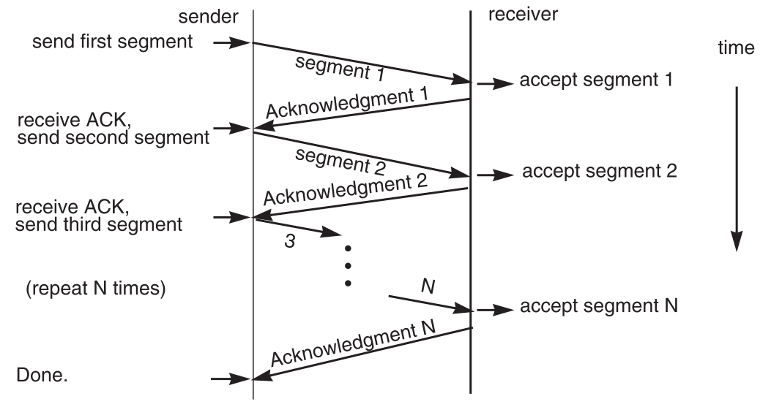
4. End-to-end performance
Multi-segment message questions
  Lock-step protocol

Slide 36
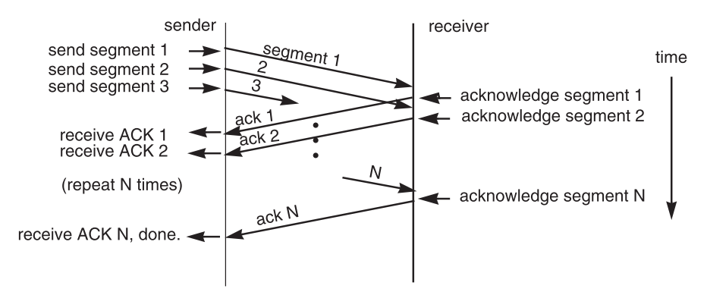
Overlapping transmissions
Pipelining technique
interval

Slide 37
Overlapping transmissions
Problems
  Packets or ACK may be lost
    Sender holds a list of segments sent, check it off when receives ACK
    Set a timer (a little more than RTT) for last segment
  If the list of missing ACK is empty, OK
  If timer expires, resend packets and another timer

Slide 38
Bottlenecks, flow control, fixed windows
Flow control
  What if the network or receiver is bottleneck?
  Window: sender starts by asking how much to send
  Receiver only ACK data arrival, not mean consumption
  What if missing/duplicating permission message?
    Require exactly-once delivery
Fixed window
  One RTT between window opening and 1st data segment
  Clever receiver can send before ready
    Requires knowing RTT, which is hard to estimate

Slide 39
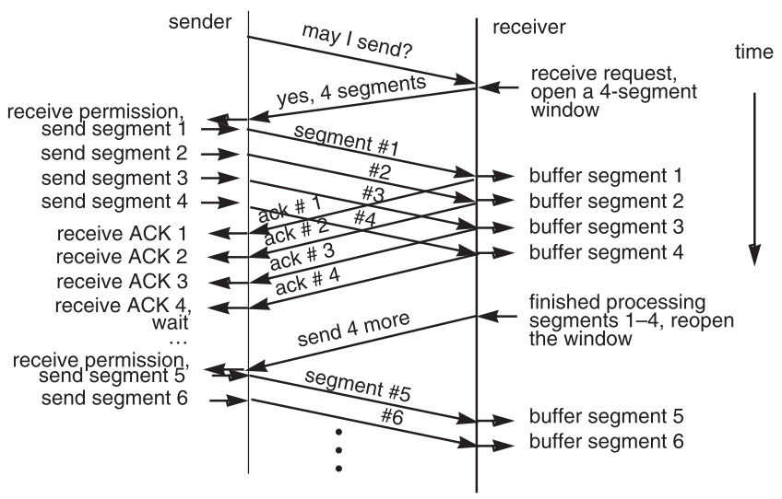
Fixed window

Slide 40
Sliding windows and self-pacing
Sliding windows
  Receiver sends permission for a window 1 segment larger
  Sender keeps track of how much window space is left, increases the number when additional permission arrives
  Automatically keep the pipeline filled
  No RTT estimation required?①
  Challenge: single algorithm under all conditions
    Bottleneck is sender: sender never waits
    Bottleneck is receiver: receiver never waits
    Bottleneck is network: keep max data rate
    How to decide the window size?

Slide 41
Sliding window size
window size ≥ round-trip time × bottleneck data rate
Sliding window with one segment in size
  Data rate is window size / RTT
Enlarge window size to bottleneck data rate
  Data rate is window size / RTT
Enlarge window size further
  Data rate is still bottleneck
  Larger window makes no sense

Slide 42
Self-pacing
Sliding window size
  Although the sender doesn’t know the bottleneck, it is sending at exactly that rate
  Once sender fills a sliding window, cannot send next data until receive ACK of the oldest data in the window
  The receiver cannot generate ACK faster than the network can deliver data elements
  e.g. receive 500 KBps, sender 1 MBps, RTT 70ms, segment carries 512 Bytes, sliding window size =
  If RTT is 1ms, the sliding window is
  RTT estimation still needed
    Needs to err on the side of being too small
Notes:
Consider RTT is 0. Similar as bounded-buffer on a single machine.

